Slide 1

Automated Traffic Sign Detection Using CNN and Transfer Learning
M.SUDHARSANAN

Slide 2
PROJECT GOALS
To develop an intelligent system that accurately classifies road signs using Convolutional Neural Networks and Transfer Learning, enhancing real-time traffic sign recognition for smart transportation solutions.

Slide 3


Road Sign Classification Dataset
Data
Test
Label.CSV

Slide 4
Data Preprocessing
Resizing Images - (224,224)
Normalization - (1/224)

Slide 5
Data Augmentation
Random Flip
→ Direction: "horizontal"
Random Rotation
→ Rotation Factor: 0.3
Random Zoom
→ Zoom Factor: 0.3
Random Contrast
→ Contrast Factor: 0.3
Random Translation
→ Height Factor: 0.2
→ Width Factor: 0.2

Slide 6
Transfer Learning with MobileNetV2
MobileNetV2, a lightweight and efficient deep learning architecture, is used as the base model to leverage pre-trained features for accurate and fast road sign classification.

Slide 7
Custom Classification Model Architecture
A sequential model was built on top of the MobileNetV2 base using Global Average Pooling, fully connected layers,
and dropout regularization to classify 30 road sign categories.

Slide 8
Model Compilation and Optimization Strategy
The model was compiled using the Adam optimizer with a learning rate of 0.0001 to ensure
stable and efficient training.
Early Stopping and Model Checkpoint callbacks were employed to prevent overfitting and save the best-performing model as best_model.keras.

Slide 9
Model Training Configuration
The model was trained for 100 epochs to allow sufficient learning while monitoring
validation performance to ensure optimal generalization.

Slide 10
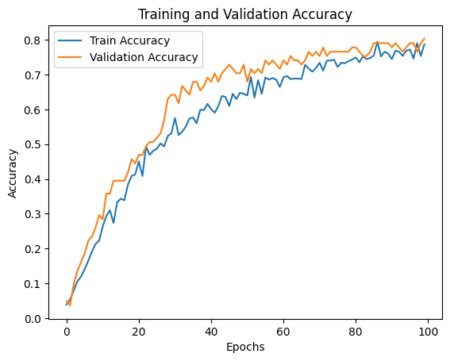
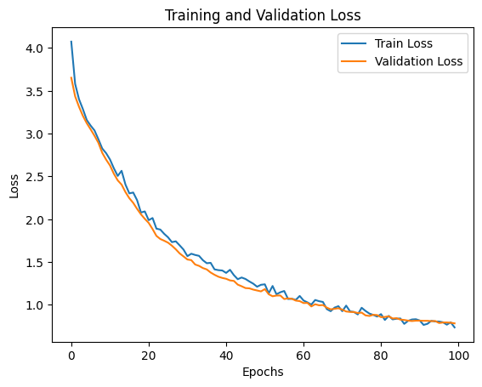
Training vs Validation Performance Analysis

Slide 11
Model Performance Summary
Achieved a best model accuracy of 80.42%, indicating strong performance on the classification task.
Final model loss of 0.7847, demonstrating effective learning and minimal overfitting.
Model was trained and evaluated using early stopping and checkpointing, ensuring optimal performance retention.

Slide 12
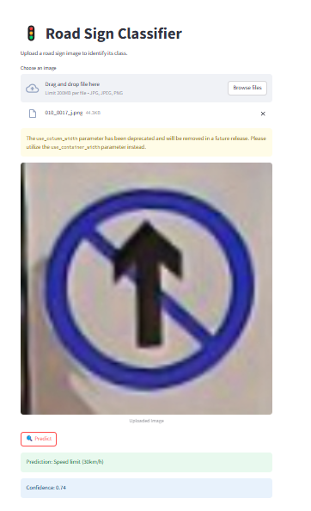
Road Sign Classification Using Streamlit Interface

Slide 13
Conclusion
This project demonstrates an effective road sign classification system using a CNN model integrated with an interactive Streamlit interface for real-time predictions.

Slide 14
THANK YOU

